Slide 1
Deep Generative Modeling
Taimoor Ul Islam (14031)

Slide 2
Table of Content
Mathematics
Optimization
Probability Distribution
Machine Learning
Supervised Learning
Learning is Finding Parameter
Unsupervised Learning
Deep Learning
Deep Learning as Function Composition
Forward and Backward Propagation
Deep Generative Modeling
Generative Models
Taxonomy of Generative Models
Research Paper

Slide 3
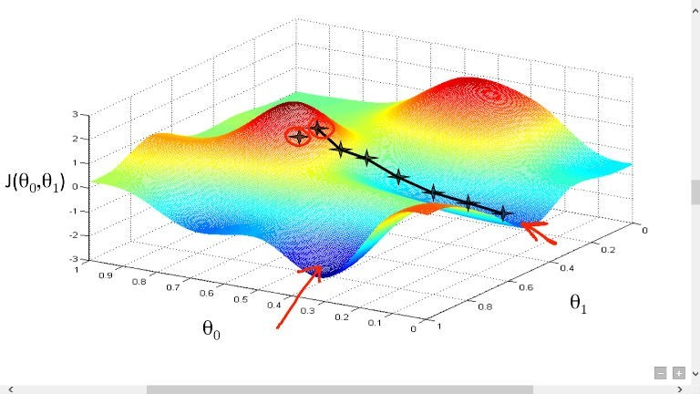
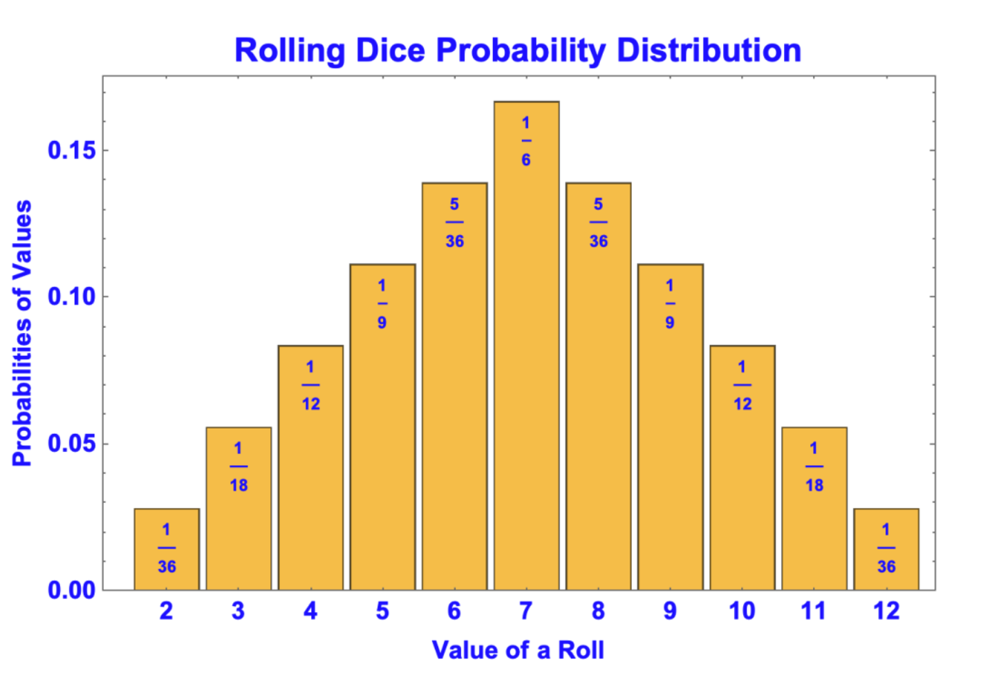
Mathematics
Optimization (Minimization)
Probability Distribution

Slide 4
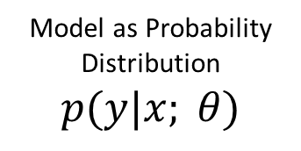
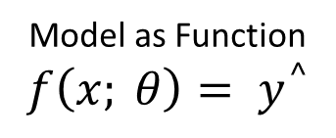

Supervised Machine Learning
Model as Function
$$f\left(x; θ\right)= y^{^}$$
Setup
x₁
x₂
.
.
.
x_{D}
_{Feature Vector}
Model
(Predictor)
y^
y
input
output
Model as Probability Distribution
$$p(y|x; θ)$$
Prediction (value, label)
True Value/ Label
Loss Function
$$l(y^{^},y)$$
$$L\left(θ\right)=l(f(x;θ),y)$$

Slide 5
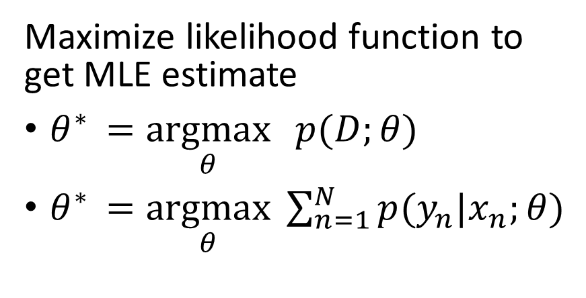
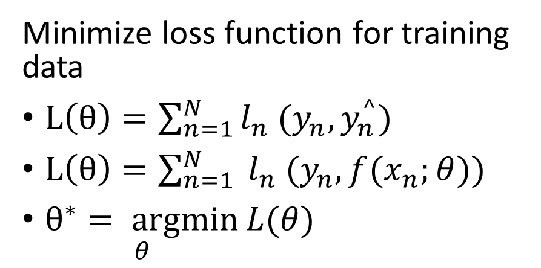
Learning is Finding Parameters
Empirical Risk Minimization
Parameter Estimation
Minimize loss function for training data
$L\left(θ\right)=\sum_{n=1}^{N}{l_{n} (y_{n},y_{n}^{^})}$
$L\left(θ\right)=\sum_{n=1}^{N}{ l_{n} (y_{n},f(x_{n};θ)})$
$\underset{θ}{θ^{∗}= argmin}{L(θ)}$
Maximize likelihood function to get MLE estimate
$θ^{∗ }=\underset{θ}{argmax}{ p(D;θ)}$
$θ^{∗ }=\underset{θ}{argmax}{\sum_{n=1}^{N}{p(y_{n}|x_{n};θ)}}$
Learn Parameter on Train Data Set
Evaluate Performance on Test Data Set

Slide 6
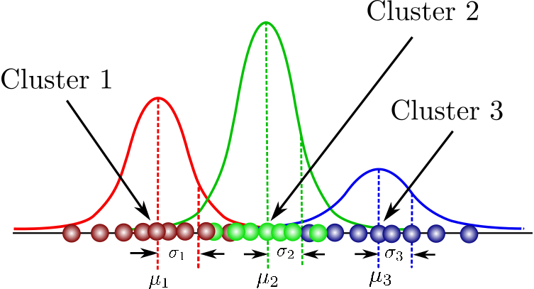
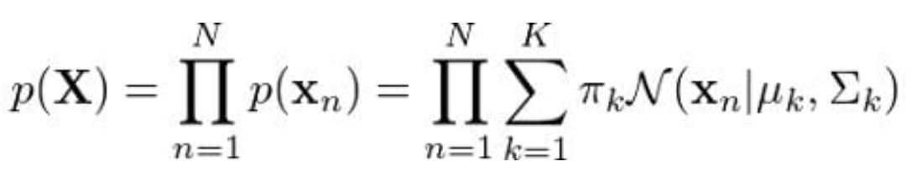
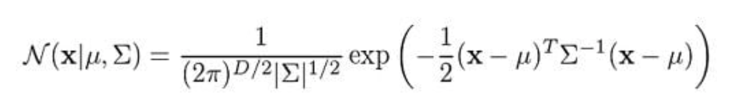
Unsupervised Machine Learning

Slide 7
Supervised Vs Unsupervised Learning
SUPERVISED LEARNING
UNSUPERVISED LEARNING
Data: (x , y)
Goal: Learn function to map x-> y
Examples: Classification, regression, object detection, image captioning etc.
Data: x
Goal: Learn some underlaying hidden structure of the data
Examples: Clustering, dimensionality reduction, feature learning, density estimation etc.

Slide 8
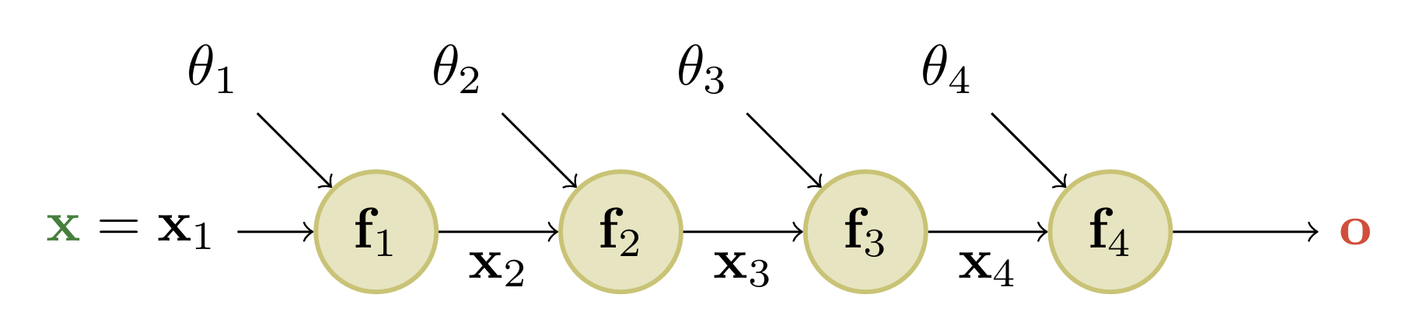

Deep Learning as Function Composition
$o=f\left(x; θ\right)$
$f\left(x;θ\right)=f_{l}\left(f_{l−1}( . . . {(f}_{1}(x;θ_{1}\right);θ_{2}) . . .;θ_{l})$

Slide 9
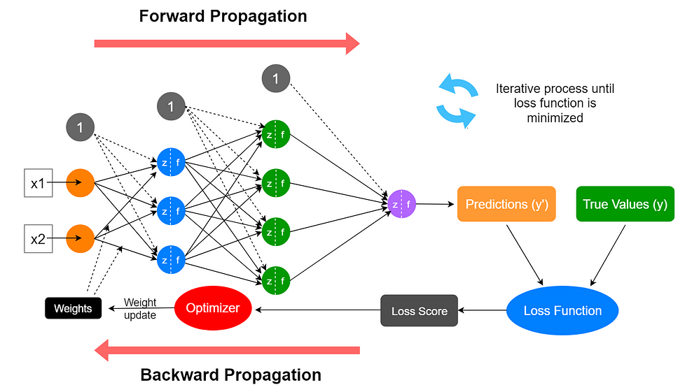
Forward and Backward Propagation

Slide 10
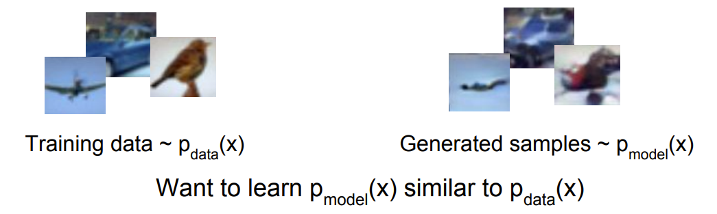
Generative Models
Given Training Data, generate same samples from it.

Slide 11
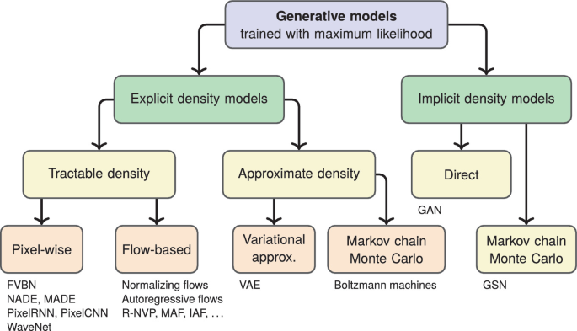
Taxonomy of Generative Models
Explicit density estimation: explicitly define and solve for pmodel(x)
Implicit density estimation: learn model that can sample from pmodel(x) with out explicitly defining it.

Slide 12
Research Paper
Approaches
Data Sets
Variational Autoencoders (VAEs)
Generative Adversarial Networks (GANs)
Normalizing Flows
Tow Moons Data Set
MNIST Data Set

Slide 13
Thank You!
Feel Free To Ask Any Question!

